Slide 1
Project 4
Clustering and TS
Vasantha M.
Debra P.
Valense A-L.
Saiyid K.a
Notes:
Valense
GM/ good afternoon for today we bring you to the world of stocks. Our Project 4 is Clustering and Time Series

Slide 2
Background Information
STOCKS
The essence of this project is incorporating the magic of Machine Learning in the realm of stock analysis, a daunting task itself. Our final objective is to visualize the results of not only clustering stocks with similar price change as well as predict and compare the results of our prediction against real-data.
Open - the price at market open when trading begins
Close - the price at market close when trading ends.
Notes:
Valense
Our Objectives was to:
Incorporate the magic of ML in the realm of stock analysis and visualize the results of not just stocks of similar price change but predict and compare the results we obtain against real world data

Slide 3

Sources of Data
Yahoo Finance
NASDAQ100
DOW30
S&P500
Notes:
Valense
We did not use a database to store and retrieve we our using a live raw feed which was Yahoo finance for our data which was read using Pandas datareader.

Slide 4
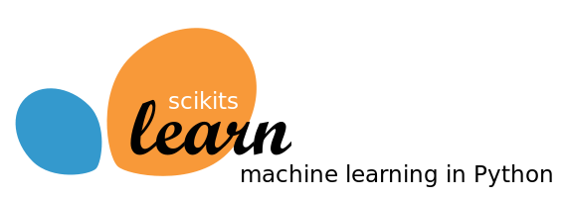

Technologies Used
Python
Pandas
DataReader
Matplotlib
HTML/CSS/Bootstrap
JQuery
LSTM
LSTM (Long Short-Term Memory) is a Recurrent Neural Network (RNN) based architecture that is widely used in natural language processing and time series forecasting.
TimeSeries
A time series is a sequence of data points that occur in successive order over some period of time.
Scikit-Learn
The Go To Machine Learning Library
Tableau
An interactive visualization Software
Notes:
Valense
Read from slides SCIKIT-Learn

Slide 5
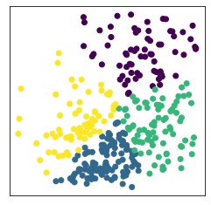
Clustering Using K-Means
Clustering
DataReader
pandas-datareader
Percent Change and Volatility
V, %Change
Standard Scaler to scale
K-Means Clustering on Scaled Data ---->
Notes:
Saiyid-Technical Analysis(Movement and Volatility)
We first imported the data using pandas-datareader and Yahoo Finance for all stocks for a 2 year period.
We then calculated each stock's daily price movement from the open and close values.
Following this, we visualized the stock market movements and saw that we needed to normalize our data.
We then used the k-means clustering algorithm on our normalized data to predict the label of each company and assigned them to 10 different clusters.
When we fit our model we decided to use PCA to help fit the model to give us more of elbow curve rather than a smoother curve
Clustering - Tableau Charts

Slide 6
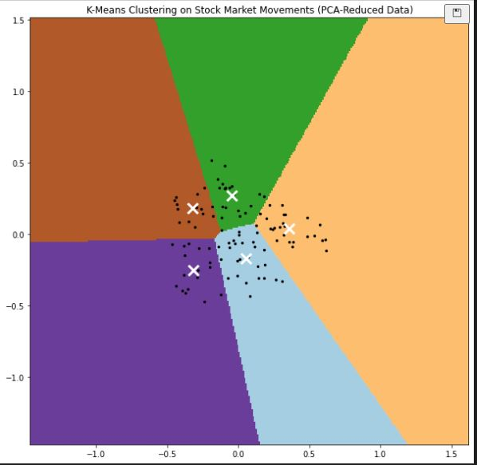
Clustering Using K-Means
Procedure
DataReader
pandas-datareader
Daily Movement
ΔDPrice
PCA to Reduce Dimensionality
n_comp based on elbow curve
K-Means Clustering on Normalized Data ---->
Notes:
Saiyid-Technical Analysis(Movement and Volatility)
We first imported the data using pandas-datareader and Yahoo Finance for all stocks for a 2 year period.
We then calculated each stock's daily price movement from the open and close values.
Following this, we visualized the stock market movements and saw that we needed to normalize our data.
We then used the k-means clustering algorithm on our normalized data to predict the label of each company and assigned them to 10 different clusters.
Finally, we saw how we can reduce the dimensionality of our data to two dimensions with principal component analysis (PCA) and plot it based on the assigned clusters.
Clustering - Tableau Charts

Slide 7
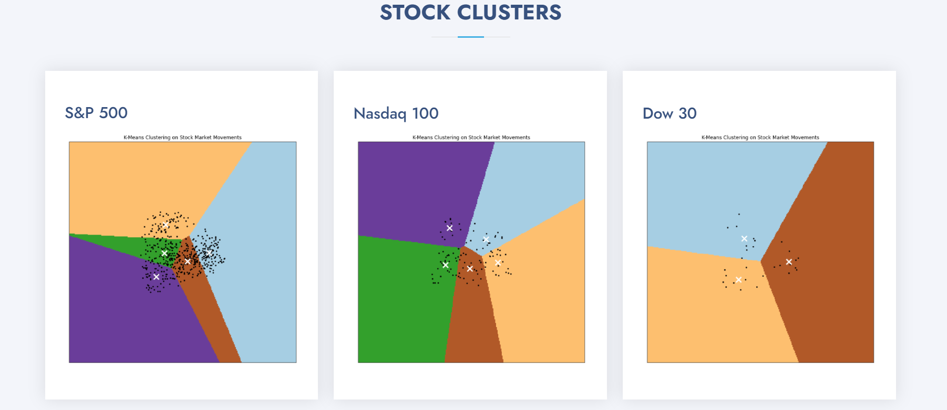
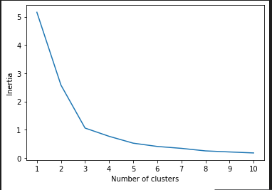
Website
Notes:
When we fit our model we decided to use PCA to help fit the model to give us more of elbow curve rather than a smoother curve

Slide 8
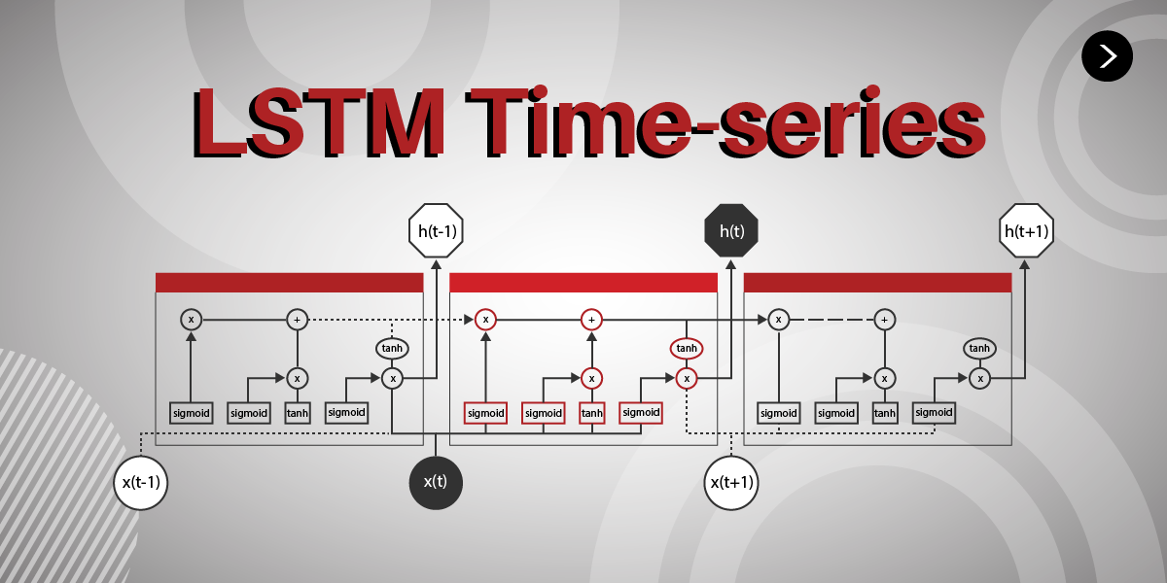
Notes:
Saiyid
Alright, one of the most advanced technology we used was LSTM time-series(Long-Short Term Memory). LSTM is Recurrent Neural Network (RNN) based architecture that integrates time series to predict future values. Time-series as we know is a forecasting model that takes successive equally spaced points to predict future values based on previously observed values. LSTM itself is based on time-series but integrates a unique Recurrent Neural Network that takes both long and short term Neural Networks whereas regular RNN can’t handle longer term propagation due to vanishing gradient problems. The cell states in LSTM allow this to occur whereas regular RNNs only have hidden states.
LSTM uses various layers
a time series is a sequence taken at successive equally spaced points in time. ... Time series forecasting is the use of a model to predict future values based on previously observed values.
-LSTM (Long Short-Term Memory) is a Recurrent Neural Network (RNN) based architecture that is widely used in natural language processing and time series forecasting. The long-term memory is usually called the cell state. The looping arrows indicate recursive nature of the cell. This allows information from previous intervals to be stored with in the LSTM cell. Using long-term
RNNs have a very unique architecture that helps them to model memory units (hidden state) that enable them to persist data, thus being able to model short term dependencies.
-Aggregation period is specific (60 -120) days
-Lags one day per prediction but uses previous times data
-Used MSE to determine accuracy
https://colah.github.io/posts/2015-08-Understanding-LSTMs/

Slide 9
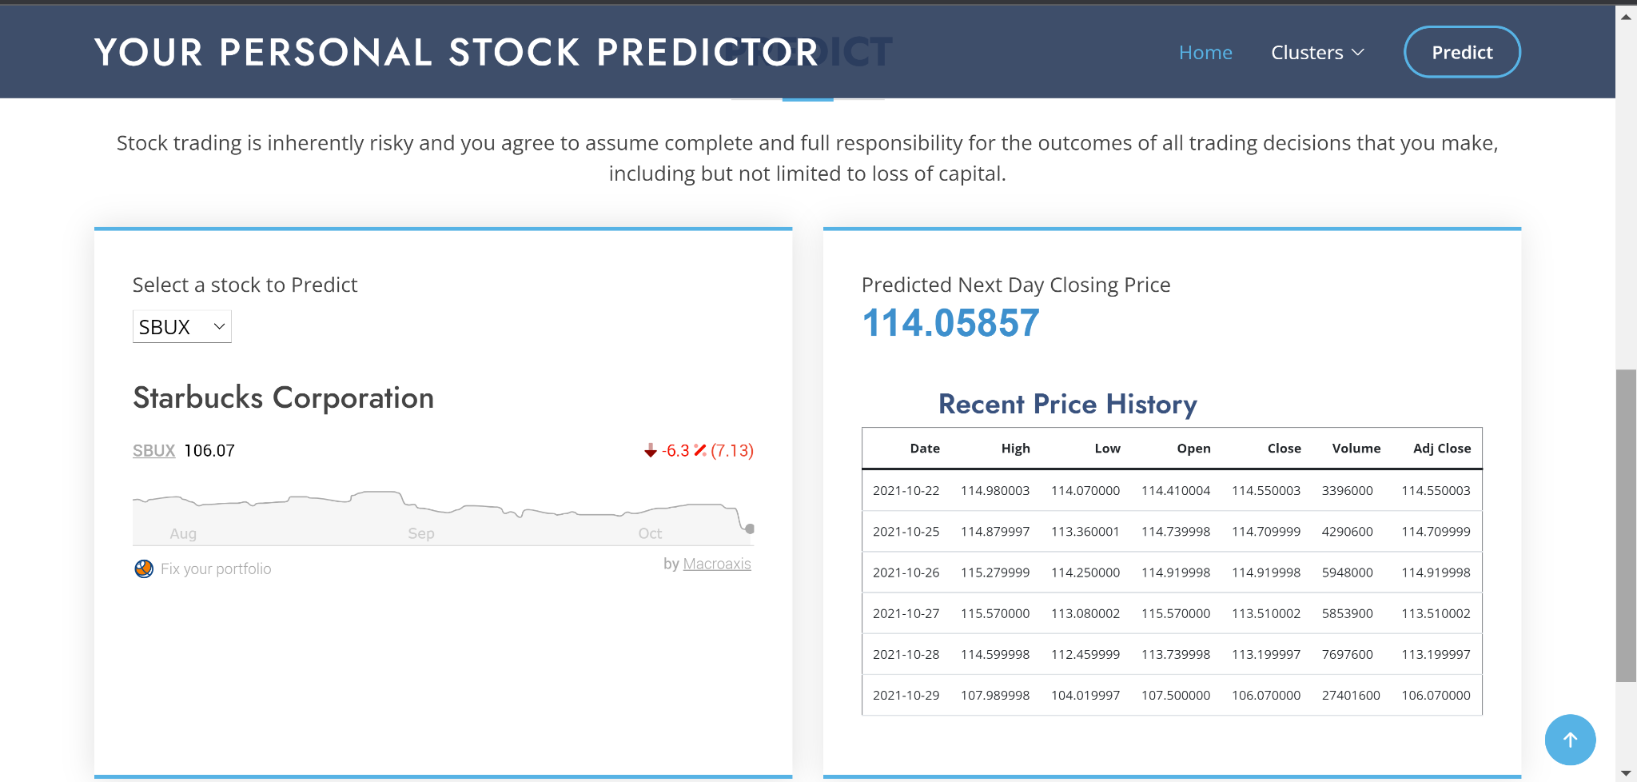
Website
Notes:
When we fit our model we decided to use PCA to help fit the model to give us more of elbow curve rather than a smoother curve

Slide 10
How this project can be extended
To forecast for n number of days
Weekly forecast
The backend code can be adopted to create
an APP to build, train, test and deploy multiple models .
As an APP to present how machine
learning might be used
Notes:
Saiyid-Technical Analysis(Movement and Volatility)
We first imported the data using pandas-datareader and Yahoo Finance for all stocks for a 2 year period.
We then calculated each stock's daily price movement from the open and close values.
Following this, we visualized the stock market movements and saw that we needed to normalize our data.
We then used the k-means clustering algorithm on our normalized data to predict the label of each company and assigned them to 10 different clusters.
When we fit our model we decided to use PCA to help fit the model to give us more of elbow curve rather than a smoother curve
Clustering - Tableau Charts

Slide 11
Questions?

